Slide 1
Electronic System Design 3: The Instrumentation Amplifier Lecture 8.2 Op Amp CMRR
Dr Duncan Bremner

Slide 2
Opamp CMRR
"Offset Voltage" of opamp varies with input voltage

Slide 3
Opamp CMRR (2)
Opamp CMRR is defined in the same way as instrumentation amp CMRR:
• Both have differential inputs
• In both cases an input of 1V common mode is equivalent
to a differential input of 1V ÷ CMRR
But:
• Instrumentation amplifiers are used without feedback
V_{OUT} = A_{V} (V_{IN}(+)–V_{IN}(–)) + A_{CM} (V_{IN}(+)+V_{IN}(–)) / 2
• Opamps use feedback so CMR error must be referred to
the input as a change in offset voltage: The differential
gain is large and ill-defined.

Slide 4
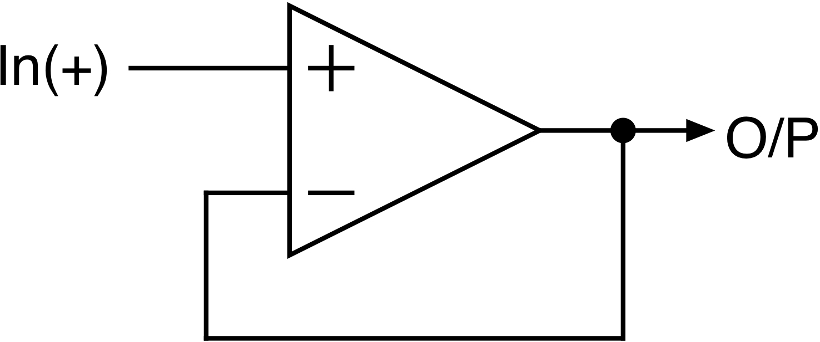
Opamp CMRR (3)
Analysis: A simple voltage follower:
Error ≈ V_{CM} ÷ CMRR

Slide 5
Typical Opamp CMRRs (4)
Wide range of CMRRs available. FET Opamps are worse:
1fA
1pA
1nA

Slide 6
Opamp CMRR (5)
Opamp CMRR may
or may not track in 2 input opamps.
If not, common-mode input
voltage gives differential O/P
up to ≈ 2*V_{CM} /CMRR
(worst case, opposite signs
For common mode gains)
Overall Instrumentation amplifier CMRR ≤ Opamp CMRR

Slide 7
Opamp CMRR (6)
FET are worse than Bipolar are worse than Chopper stabilised:
Typ / Worst Case
Typ / Worst Case
Best chopper is
158dB CMRR (typ) 135dB worst case
0.3µV V_{OS} (typ) 2.5µV worst case with sub-nA Ib
I cannot find one better than this…..

Slide 8

Thank you
谢谢

